Slide 1


SMART INDIA HACKATHON 2026
This title slide presents Smart India Hackathon 2026 Problem Statement 26193, titled AI-Powered Post-Harvest Decision Intelligence App, under Agriculture, FoodTech and Rural Development, Software category. The team name is AgriNexus. The large Smart India Hackathon lightbulb graphic visually represents artificial intelligence, digital technology and innovation for the hackathon.
TITLE PAGE
•
•
•
•
•
•
Problem Statement ID – 26193
Problem Statement Title- AI Powered Post-Harvest Decision Intelligence Platform
Theme- Agriculture, FoodTech & Rural Development
PS Category- Software
Team ID-
Team Name - AGRINEXUS

Slide 2

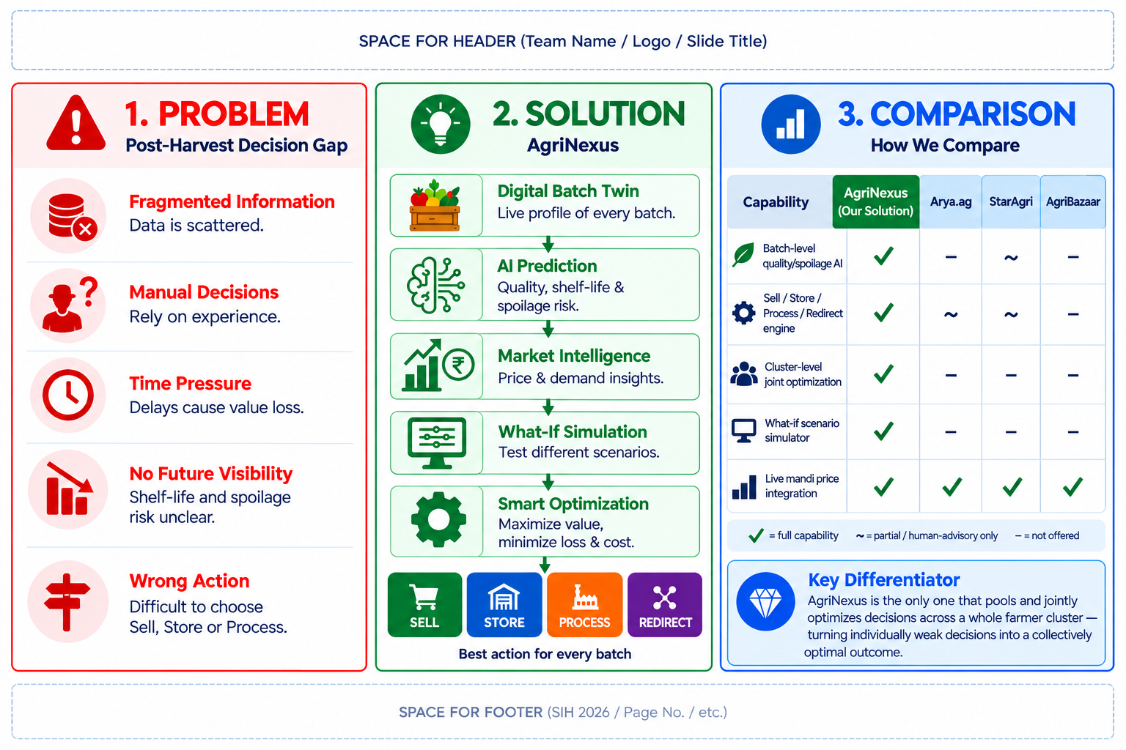
AGRINEXUS — AI-Powered Post-Harvest Decision Intelligence Platform
AI EVALUATION SUMMARY: AgriNexus addresses the post-harvest decision gap by integrating crop-batch condition, shelf-life, spoilage risk, market price, demand and other agricultural data. It supports four actions: SELL, STORE, PROCESS and REDIRECT. Its differentiators are batch-level AI, what-if simulation and joint optimization across a farmer cluster.
This slide explains the AgriNexus post-harvest decision problem, proposed solution and differentiation.
LEFT PANEL — PROBLEM: farmers face fragmented agricultural information, manual experience-based decisions, time pressure, limited future visibility about shelf-life and spoilage risk, and difficulty choosing among selling, storing, processing or redirecting a harvested batch.
MIDDLE PANEL — SOLUTION: AgriNexus creates a Digital Batch Twin, an up-to-date profile for each harvested batch; AI Prediction estimates quality, shelf-life and spoilage risk; Market Intelligence uses price and demand insights; What-if Simulation tests alternative scenarios; Smart Optimization selects an action intended to maximize value while reducing loss and cost. The four recommended actions shown are SELL, STORE, PROCESS and REDIRECT.
RIGHT PANEL — COMPARISON: a capability matrix compares AgriNexus with Arya.ag, StarAgri and AgriBazaar across batch-level quality/spoilage AI, sell/store/process/redirect engine, cluster-level joint optimization, what-if scenario simulation and live mandi price integration. The slide identifies cluster-level joint decision optimization as AgriNexus's key differentiator.
SMART INDIA HACKATHON 2026

Slide 3
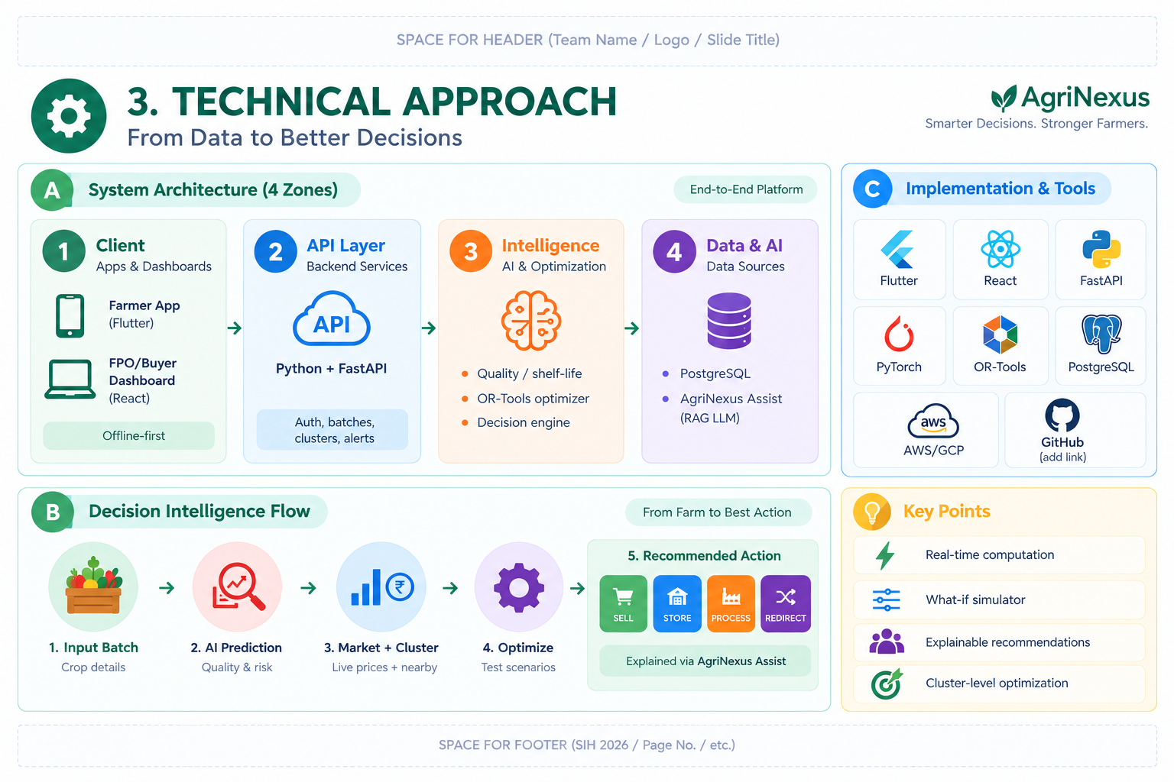
TECHNICAL APPROACH
AI EVALUATION SUMMARY: AgriNexus follows an integrated pipeline: data collection and validation → digital batch twin → AI prediction → market intelligence → what-if simulation → optimization → actionable recommendation. Data references include Soil Health Card, AGMARKNET/e-NAM, IMD weather and ICAR agricultural knowledge.
This technical approach slide describes the AgriNexus end-to-end architecture and decision flow.
SYSTEM ARCHITECTURE has four zones:
Zone 1- Client includes a Flutter farmer app and React FPO/buyer dashboard with offline-first design;
Zone 2 - API Layer uses Python and FastAPI backend services for authentication, batches, clusters and alerts;
Zone 3 - Intelligence contains AI and optimization components for quality and shelf-life prediction, OR-Tools optimization and a decision engine;
Zone 4 - Data and AI contains data sources including PostgreSQL and AgriNexus Assist, a RAG-based language model. IMPLEMENTATION TOOLS shown are Flutter, React, FastAPI, PyTorch, OR-Tools, PostgreSQL, AWS/GCP and GitHub.
DECISION INTELLIGENCE FLOW:
1. Input Batch with crop details;
2. AI Prediction for quality and risk;
3. Market + Cluster using live prices and nearby information;
4. Optimize by testing scenarios;
5. Recommended Action selects SELL, STORE, PROCESS or REDIRECT and is explained through AgriNexus Assist. Key points are real-time computation, what-if simulation, explainable recommendations and cluster-level optimization.
IMAGE EXPLANATION — TECHNICAL APPROACH: This visual represents the end-to-end AgriNexus technical architecture. Data sources include farmer/crop information, Soil Health Card data, AGMARKNET/e-NAM mandi prices, weather information from IMD, crop/agriculture knowledge from ICAR, and post-harvest batch observations. The system creates a batch-level digital twin, processes data through AI/ML models for quality, shelf-life, spoilage risk, price and demand prediction, then uses scenario simulation and optimization to select an action. The final decision-support outputs guide the farmer toward SELL, STORE, PROCESS or REDIRECT. The architecture emphasizes data integration, AI prediction, what-if analysis, optimization and actionable recommendations.
SMART INDIA HACKATHON 2026

Slide 4
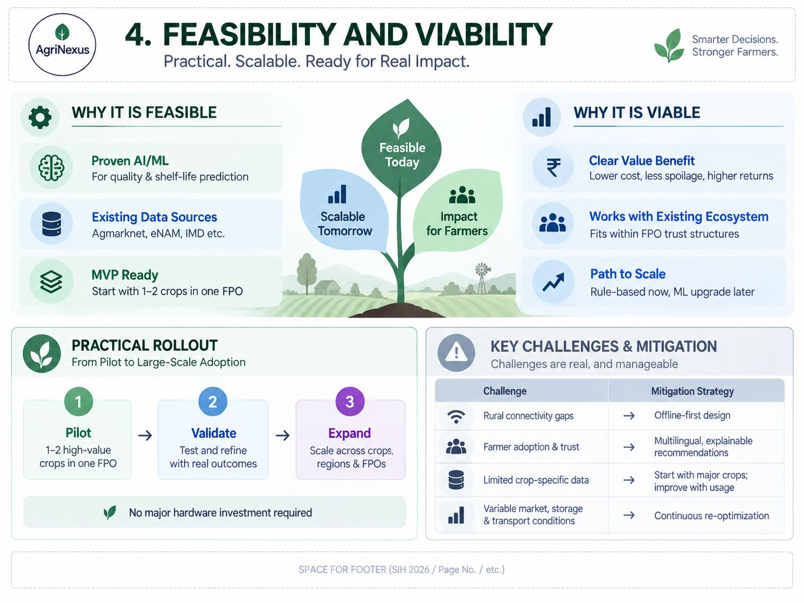
FEASIBILITY AND VIABILITY
This feasibility and viability slide explains why AgriNexus can be developed and adopted.
FEASIBILITY: proven AI/ML methods can support quality and shelf-life prediction; existing data sources include Agmarknet, eNAM and IMD; and an MVP can start with one or two crops in one FPO. The central graphic represents a solution that is feasible today, scalable tomorrow and intended to create impact for farmers.
VIABILITY: the proposed value benefits are lower cost, less spoilage and higher realized returns; the platform is designed to work with the existing FPO ecosystem and trust structures; and it has a path to scale from rule-based logic to later ML upgrades.
PRACTICAL ROLLOUT has three stages: Pilot with 1–2 high-value crops in one FPO; Validate by testing and refining with real outcomes, and Expand across crops, regions and FPOs. The slide states that no major hardware investment is required.
KEY CHALLENGES AND MITIGATION: rural connectivity gaps are addressed through offline-first design; farmer adoption and trust through multilingual and explainable recommendations; limited crop-specific data by starting with major crops and improving with usage; and variable market, storage and transport conditions through continuous re-optimization.
IMAGE EXPLANATION — AGRINEXUS FEASIBILITY AND VIABILITY CONTENT: The visual explains implementation feasibility for AgriNexus. It presents the solution as software that can combine existing agricultural data sources, AI/ML prediction, market intelligence, simulation and optimization.
The feasibility argument focuses on using available digital data and scalable cloud/software components rather than requiring specialized physical infrastructure.
The viability section connects the system to farmer decision-making and potential reduction of post-harvest losses through timely sell, store, process or redirect recommendations.
SMART INDIA HACKATHON 2026
4

Slide 5
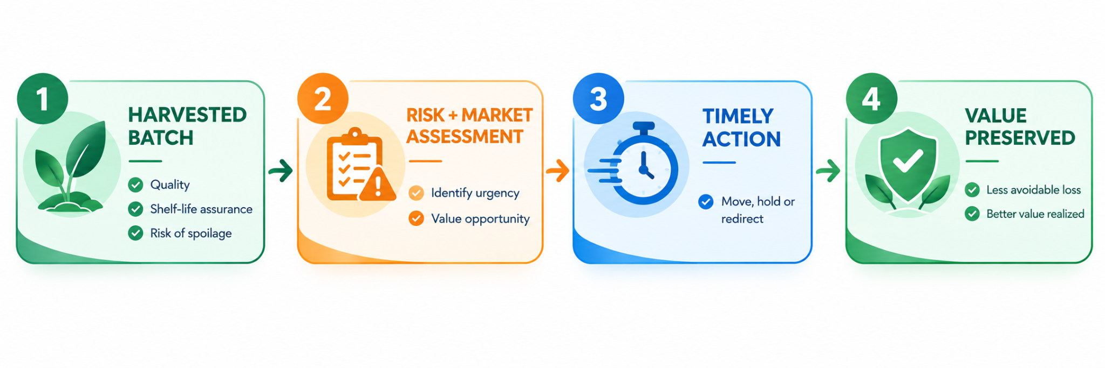
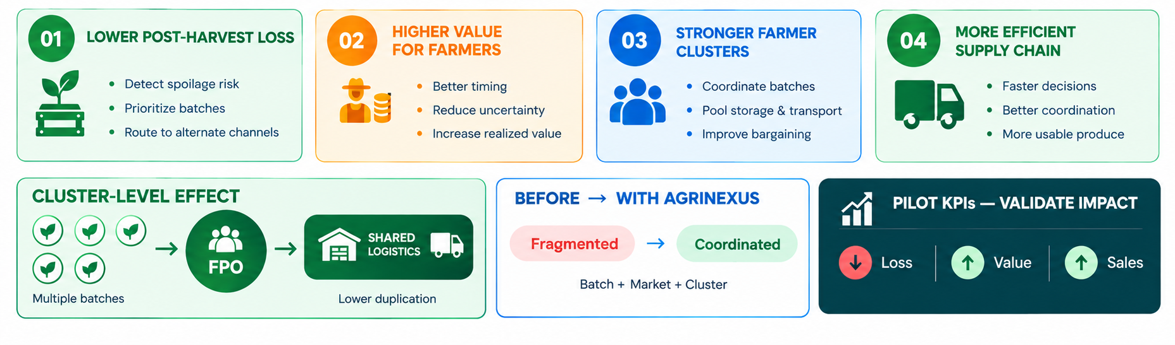
IMPACT AND BENEFITS
This slide presents the intended post-harvest workflow, impact and benefits of AgriNexus.
TOP FLOW: The workflow begins with a Harvested Batch, where the quality, shelf-life assurance and risk of spoilage are assessed. This is followed by Risk + Market Assessment, which identifies the urgency of the batch and the available value opportunity. Based on these insights, Timely Action is taken to decide whether the batch should be moved, held or redirected. The final outcome is Value Preserved, with the objective of achieving less avoidable loss and better realized value from the harvested produce.
IMPACT: The overall impact of AgriNexus is to support timely, data-driven post-harvest decisions that reduce avoidable losses and help preserve the value of produce. By connecting batch assessment, market and risk evaluation, and timely action, the solution aims to improve realized value and sales while enabling better coordination between batch, market and cluster-level decisions.
BENEFITS: The major benefits are:
Lower Post-Harvest Loss: Spoilage-risk detection, batch prioritization and alternate-channel routing help reduce avoidable losses.
Higher Value for Farmers: Better timing, reduced uncertainty and improved realized value help farmers achieve better outcomes from their produce.
Stronger Farmer Clusters: Coordinated batches, pooled storage and transport, and improved bargaining strengthen cluster-level and FPO-level coordination.
More Efficient Supply Chain: Faster decisions, better coordination and more usable produce help improve supply-chain efficiency.
At the cluster level, multiple batches can be coordinated through an FPO using shared storage and transport, helping reduce duplication in logistics. The Before → With AgriNexus visual represents the shift from fragmented operations to coordinated Batch + Market + Cluster decisions.
The slide also defines Pilot KPIs to validate the solution’s impact, focusing on Loss ↓, Value ↑ and Sales ↑.
SMART INDIA HACKATHON 2026

Slide 6
RESEARCH AND REFERENCES
This slide lists research and reference sources used for the AgriNexus concept: Soil Health Card from the Ministry of Agriculture and Farmers Welfare/NIC; AGMARKNET from the Government of India; e-NAM, the National Agriculture Market; India Meteorological Department (IMD); Indian Council of Agricultural Research (ICAR); and ICAR Crop Agro-Advisories. The stated research gap is that existing platforms provide separate agricultural services, while AgriNexus proposes integrating them into one AI-powered farmer platform. The stated key objective is to help farmers make timely, data-driven decisions, reduce avoidable farming losses and improve overall crop profitability.
1. Soil Health Card – Ministry of Agriculture & Farmers Welfare / NIC
https://soilhealth.dac.gov.in/
2. AGMARKNET – Government of India
https://agmarknet.gov.in/
3. e-NAM – National Agriculture Market
https://www.enam.gov.in/
4.India Meteorological Department (IMD)
https://mausam.imd.gov.in/
5.ICAR – Indian Council of Agricultural Research
https://icar.gov.in/
6.ICAR Crop Agro-Advisories
https://icar.gov.in/
Research Gap - Existing platforms provide separate agricultural services; our solution integrates them into one AI-powered farmer platform.
Key Objective - To help farmers make timely, data-driven decisions, reduce avoidable farming losses and improve overall crop profitability.
SMART INDIA HACKATHON 2026

